Slide 1
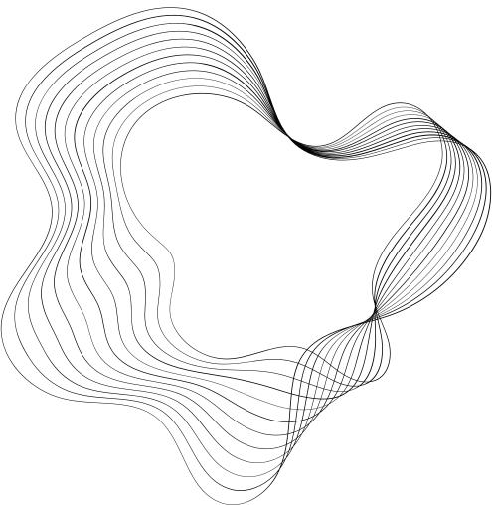


AI SONNETS
AI SONNETS

Slide 2

CONTENT
01
OUR TEAM
05
UNIQUENESS
02
ABOUT THE PROJECT
06
APPLICATIONS
03
IMPORTANCE OF POETRY
07
WHAT'S NEW?
04
SOLUTION
08
IMPACT TO NATION

Slide 3



OUR TEAM
Rithuraj Nambiar
Developer

Slide 4





ABOUT THE PROJECT
Poetry holds significance in multiple aspects, such as conveying emotions, representing cultural values, and providing historical insights.
Sonnets, a form of poetry, hold great importance in English literature. Among William Shakespeare's 184 sonnets, "Shall I Compare Thee to a Summer's Day?" is widely regarded as a profoundly romantic poem according to numerous critics.
The ideology of the project is to use Generative Adversarial Network to create a promising generator that would generate Shakespeare-like Sonnets.

Slide 5
ABOUT THE PROJECT
DATASET CONSISTING OF 184 SONNETS BY WILLIAM SHAKESPEARE
AI MODEL FOR GENERATING POEMS
EMITING POEMS ON THE PORTAL
ADDED ADDITIONAL VOCABULARY FROM OTHER WORKS OF WILLIAM SHAKESPEARE

Slide 6




IMPORTANCE OF POETRY
Poetry can express emotions in a way that prose cannot.
Poetry can convey complex feelings and experiences that are difficult to articulate in other forms of writing.
Poetry has played an important role in many cultures throughout history.
It has been used to preserve cultural traditions, to celebrate important events, and to express the values and beliefs of a community.
Poetry can provide insight into the past and help us understand the attitudes and values of people in other times and places.
Many poets have written about historical events and social issues, providing a window into the past.
EMOTIONAL EXPRESSION
CULTURAL SIGNIFICANCE
HISTORICAL PERSPECTIVE

Slide 7

SOLUTION
Training machine learning models on vast amounts of written texts to generate poems that imitate human-like language and style.
These models use complex algorithms to analyze and understand the patterns and structures of language, allowing them to generate unique and creative pieces of poetry that are often indistinguishable from human-written ones.
AI-generated poetry has various potential applications, including creative writing, marketing, and entertainment.
Additionally, it offers a new and exciting way to explore the boundaries of artificial intelligence and its ability to replicate human creativity.

Slide 8



UNIQUENESS
The existing models for this purpose only use vocabulary from either the plays or poems.
We have used the vocabulary from the plays as well to improve the quality of content.
Most of the work done on similar grounds use standard deep learning techniques but instead we are using GAN, that would produce more human-like predictions.
GAN improvises with every epoch in order to make the prediction more human-like.

Slide 9

APPLICATIONS
“The application of a project determines its true value. It is through practical implementation that ideas come to life, creating tangible impact and transforming possibilities into reality.”
AI-generated poems can be written in a wide range of styles and formats, allowing for greater diversity in the poetry community.
Marketing agencies would benifit a lot from these as it would help them generate promotional poems.
AI-generated poems can explore new ideas and concepts that humans may not have considered.
3
1
2

Slide 10
APPLICATIONS
AI sonnets can be utilized in therapeutic contexts, such as art therapy or creative writing programs, to help individuals express emotions.
AI-generated sonnets can serve as a source of inspiration for poets, writers, and artists.
AI sonnets can be used in educational settings to teach poetry, literature, and creative writing.
7
5
6
Notes:
5 Creative Inspiration: They can provide unique and unconventional perspectives, sparking new ideas and pushing the boundaries of traditional artistic expression
6 Education Tool: They can help students explore different poetic forms, styles, and themes, fostering a deeper understanding and appreciation of literature.
7: Therapeutic and Expressive Arts: to help individuals express emotions, promote self-reflection, and enhance well-being. They can serve as prompts for personal exploration and catharsis.

Slide 11
WHAT'S NEW?
Improvised Vocabulary
- Data from plays of Shakespeare has been integrated into the model to make the prediction more precise.

Slide 12
WHAT WE ARE WORKING ON?
Fine tuning the model – Plans on integrating transfer learning and GPT models.
Conditional Generation- incorporating specific prompts, themes, or constraints on the generation from user.
Notes:
Conditional Generation - the AI model can generate sonnets that align with desired criteria or follow a given structure, enabling users to influence the output and tailor it to their needs.

Slide 13


IMPACT ON NATION
Cultural Enrichment: AI sonnets can contribute to the cultural fabric of a society by expanding artistic expression and promoting creativity.
Educational Opportunities: AI sonnets can be used as educational tools to engage students and promote interdisciplinary learning.
Innovation and Entrepreneurship: AI sonnets demonstrate the possibilities and potential of AI technology in creative endeavors.
Global Recognition and Soft Power: Projects that showcase the creative and technological capabilities of a country, such as AI sonnets, can enhance a nation's global recognition and influence.

Slide 14

FUTURE OPPORTUNITY
Enhanced Creative Collaboration: AI sonnets can be used as collaborative tools, where human poets and AI algorithms work together to co-create poetry.
Style Transfer and Adaptation: AI sonnets can be trained to mimic the style of specific poets or periods, allowing for the generation of sonnets that closely resemble the works of renowned poets
Multimodal Expressions: AI sonnets can be combined with other forms of media, such as visual art or music, to create multimodal artistic experiences.

Slide 15

AI SONNETS
THANK YOU

